Slide 1

Notes:
Main Page

Slide 2

Fall Project
Grace, Jason, Madeleine, Nikhil, Patrick
October 7, 2021
Engineering
Notes:
Intro Title Page

Slide 3
October 7, 2021
Today’s Agenda
Project Variation
General Approach
Backup Approach
Fall Project
Notes:
Typical Page

Slide 4

Project Variation
Mentos and Coke
Constant Pressure (B)
Fall Project

Slide 5
Why We Chose Coke and Mentos
Easy to replenish for multiple attempts
Consistent reaction
Reactants easy to mix
Allows to plan for an exact pressure
Fall Project

Slide 6
Why We Chose Target B
Within our skill range
Can always go higher to C, is a pressure container is successful

Slide 7
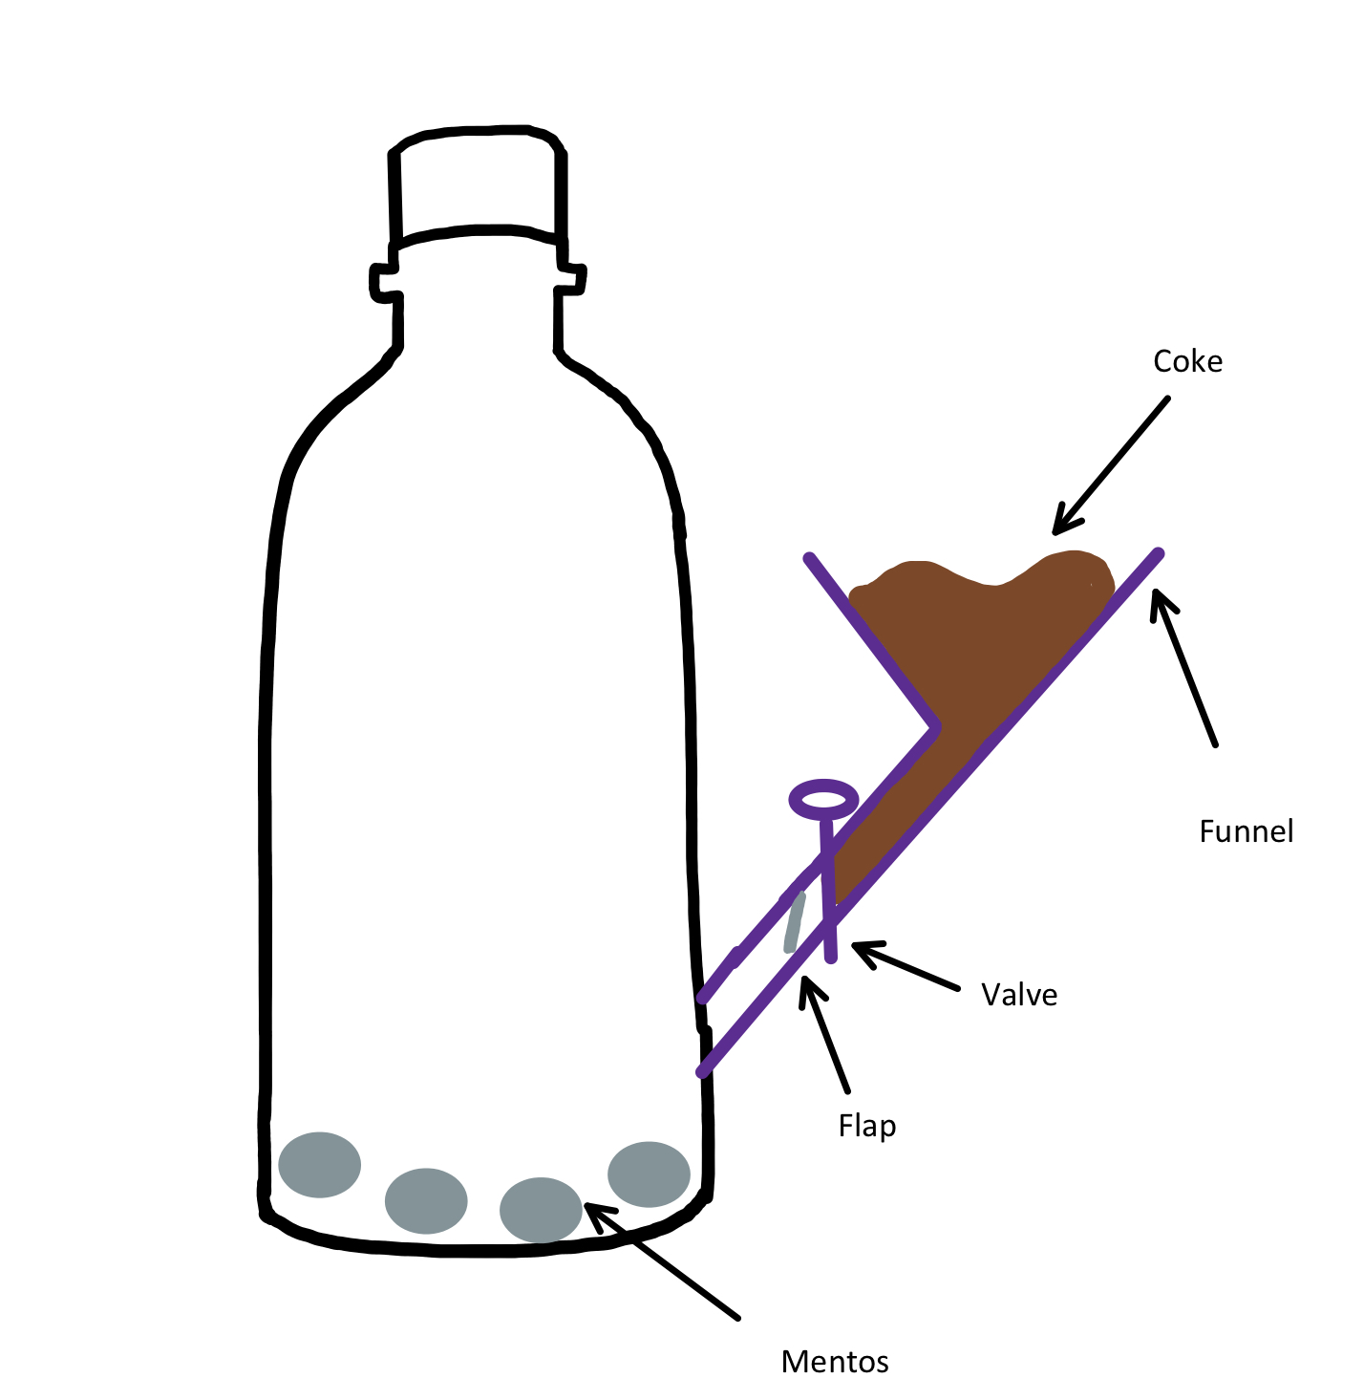
General Approach
Simple design following Occam's razor
Design consists of bottle, funnel, nozzle, and flap
Fall Project

Slide 8

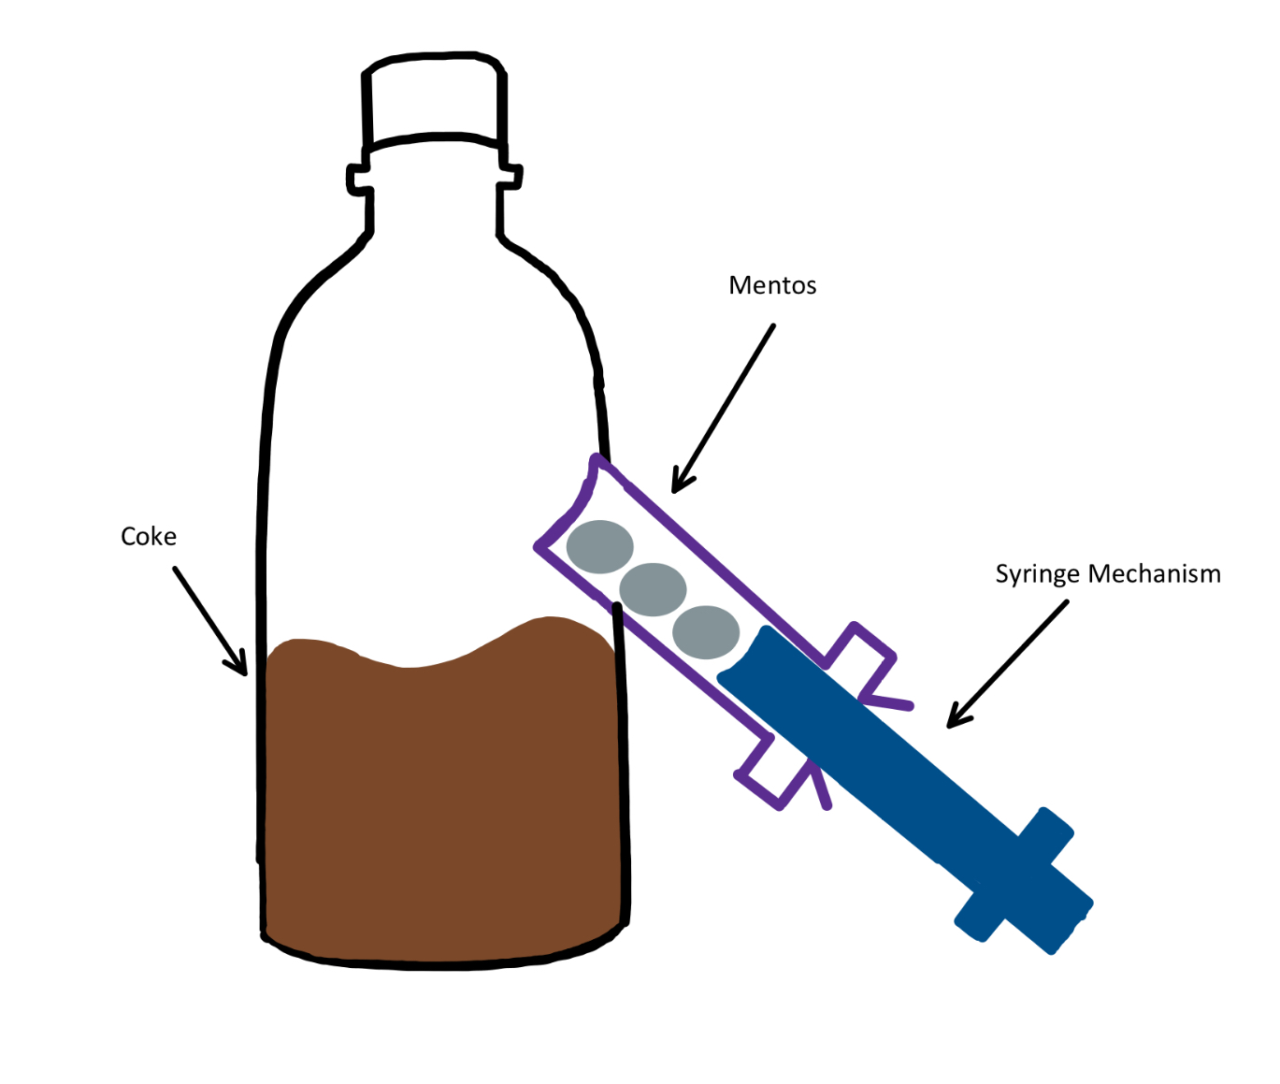
Backup Approach
Simple design
Locking mechanism to prevent leakage
Fall Project
Notes:
Title Page

Slide 10
Conclusion

Slide 11
Notes:
Main Page

